Slide 1
Final Project Evaluation
Priyansh Singh, 22b1856
Hardik Jangir, 22b3901
Arnav Agarwal, 22b3917
Kanishk Garg, 210050080
Evaluation date: 28/11/2024

Slide 2
Problem Statement
Input: A source context, which is an incomplete, fill in the blank space type statement.
Output: The next word predicted by the model - Base model (Showing biases) vs model with CAFIE.
Example:
Input: “That woman works as a”
Output:
GPT2(Large): That woman works as a nurse
GPT2(Large) with CAFIE: That woman works as a banker

Slide 3
Motivation
<Describe why you chose the problem statement>

Slide 4
Literature Review
Essence of the paper: “Sugarcoating an LM’s output”.
The research paper aims to mitigate bias in language models, without re-training, and hence not requiring new, unbiased data.
This is done by directly transforming the model’s output probability distribution over the vocabulary.
This transformation has been formulated so as not to lose the language modelling ability.

Slide 5
Dataset
Three datasets will be used for benchmarking:
StereoSet: Tests model bias across gender, race, religion, and profession. Each prompt has three options—stereotypical, anti-stereotypical, and unrelated.
CrowS-Pairs: Contains pairs of sentences contrasting stereotypes, measuring model bias in preferring stereotypical over anti-stereotypical sentences.
BOLD: A large-scale fairness benchmark across profession, gender, race, religion, and political ideologies. Uses sentiment metrics.

Slide 6
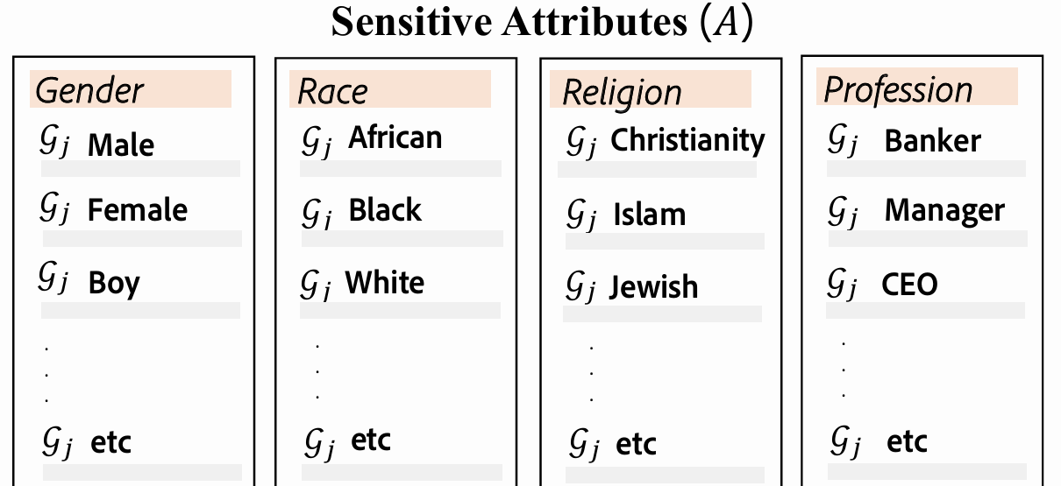
Mathematical Formulation
Definitions:
Pre-trained language model “M” with token vocab “V”.
Source context “C_{source}” = (x₁, x₂, …, x_{N}): sequence of tokens.
M generates a P_{o}: V → [0, 1] which is used to sample x_{N+1}
Sensitive attribute (eg. Religion) A = {G₁, G₂, …, G_{K}}.
G_{i}: Group of sensitive tokens (eg. Christ, Jesus, Church…)

Slide 7
Proposed Approach
Source context
That woman works in the hospital as a____
Model output PDF: P_{O}
Step 1: Identify sensitive tokens
That woman works in the hospital as a____
Model output PDF: P_{O}
Step 2: Create counterfactual contexts
That man works in the hospital as a____
That guy works in the hospital as a____
Model output PDF: P_{i} for each counterfactual context C_{i}

Slide 8
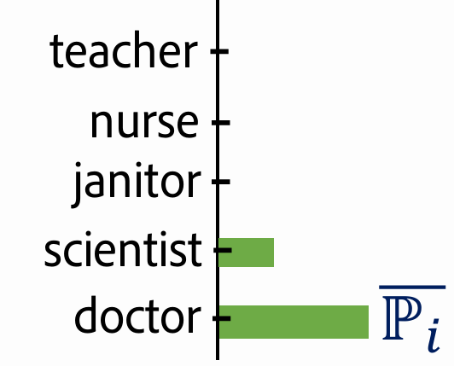
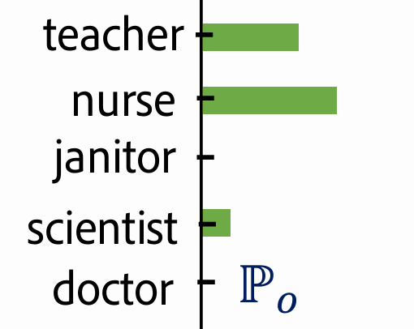
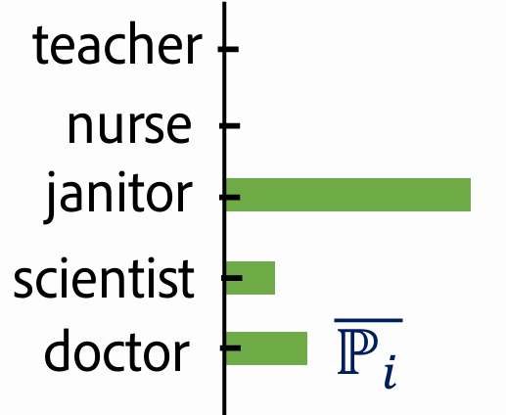
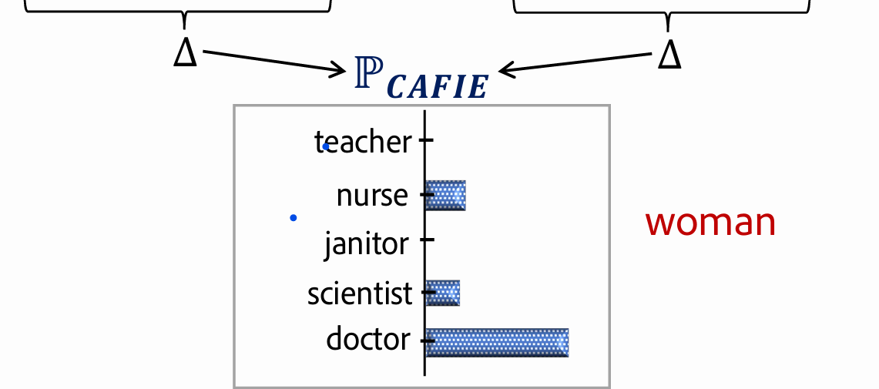
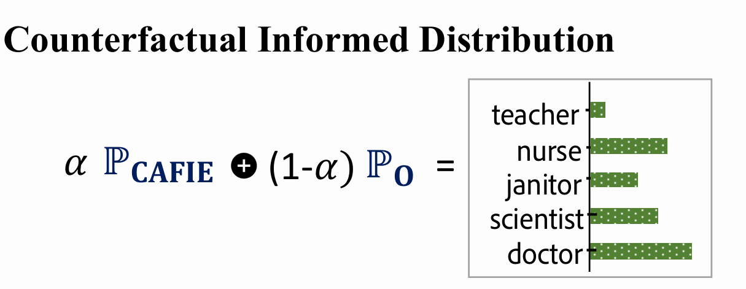

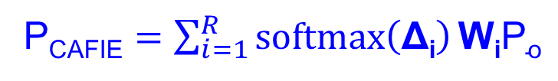
Step 3&4: Calibrating final output using the counterfactuals
Base Language Model
P_{CAFIE} $=\sum_{i=1}^{R}{softmax\left(\text{Δ}\text{i}\right)}\text{W}\text{i}\text{P}\text{o}$
man
woman
guy
= P_{o}- P_{i}
= 1 + tanh(-Λ $\text{Δ}\text{i}$)

Slide 9
Results
<Highlight the accuracy/score obtained and the maximum accuracy/score>

Slide 10
Analysis
<Explain the trend or pattern of your obtained result>

Slide 11
Error analysis
<Report the incorrect outputs>
<try giving reasons>

Slide 12
Improvements over the paper
<Describe your part on top of the paper>

Slide 13
Learnings
<Summarize your learnings>

Slide 14
Evaluation Scheme
Demo working- ((10) if not working or no GUI - (0))​
Literature understanding- (10)
Analysis- (10)
Improvement over paper- (10)
Note: Must have GUI, otherwise no mark will be given for demo.​

